Slide 1

Week 5
- STLs -

Slide 2
String

Slide 3
|String
An array of characters with more properties and built-in functions.
"ACM"
"Mohamed"
"How are you ?"
0 | 1 | 2
A | C | M
0 | 1 | 2 | 3 | 4 | 5 | 6
M | o | h | a | m | e | d
0 | 1 | 2 | 3 | 4 | 5 | 6 | 7 | 8 | 9 | 10 | 11 | 12
H | o | w |  | a | r | e |  | y | o | u |  | ?

Slide 4
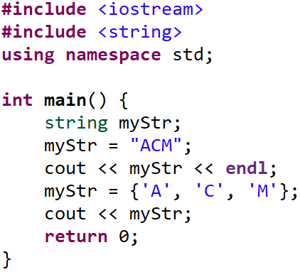
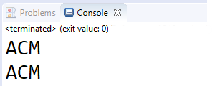
|String

Slide 5
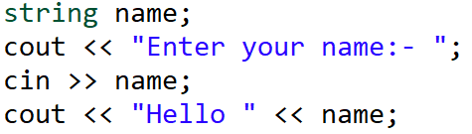
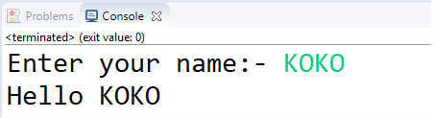
|String

Slide 6
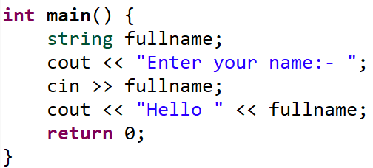
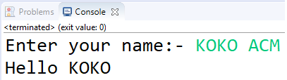
|String
The word "ACM" is neglected!!

Slide 7
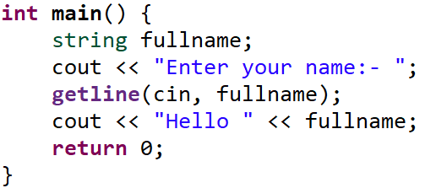
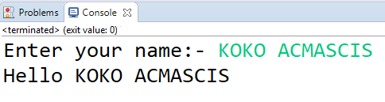
|String
getline()
Reads more than one word separated by spaces on the same line.

Slide 8
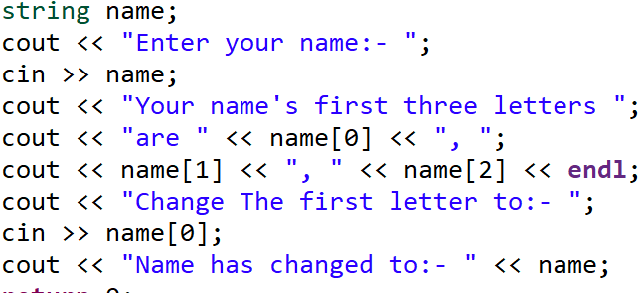
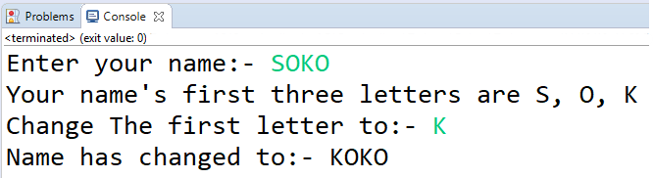
|String

Slide 9
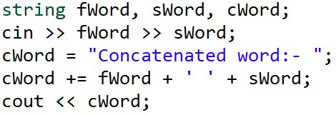
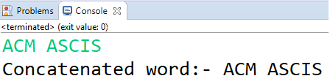
|String concatenation
"AB" + "CD" = "ABCD"

Slide 10
|Challenge
Given two words determine if the second one is a part of the first or not.

Slide 11
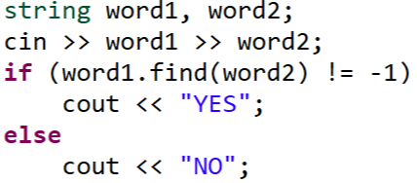
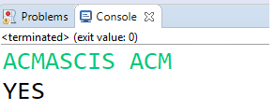
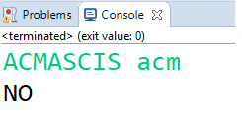
|String
.find()
Takes a string as a parameter and returns the index of the first letter of the string if found else it returns string::npos (-1) if the string is not found.

Slide 12
Vector

Slide 13
|Vector
An array of unallocated size that increments by pushing elements into it.

Slide 14
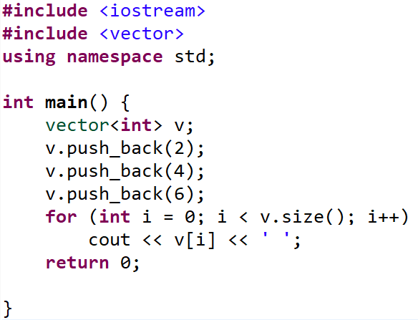

|Vector
.push_back()
Adds a new element at the end of the vector.
.size()
Returns the size of the vector.

Slide 15
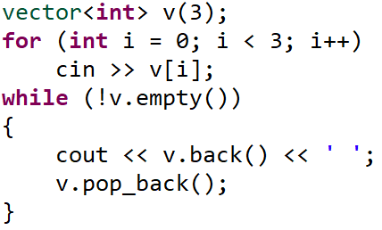
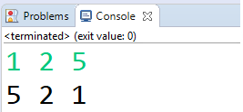
|Vector
.empty()
Returns true if the vector is empty.
.pop_back()
Removes the last element in the vector.
.back()
Returns a reference to the last element in the vector.

Slide 16
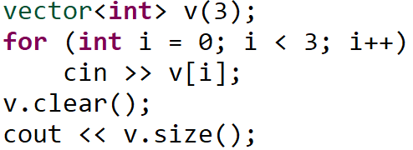
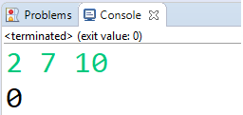
|Vector
.clear()
Removes all elements from the vector.

Slide 17
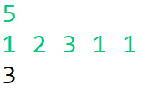
|Exercise
Koko doesn’t like the first and the last book on a bookshelf to have the same number of pages. Has to keep removing the last book until he finds a book with different number of pages. Given the number of the books on the shelf N and N numbers which are the numbers of pages for each book , print number of the books left on the shelf.

Slide 18
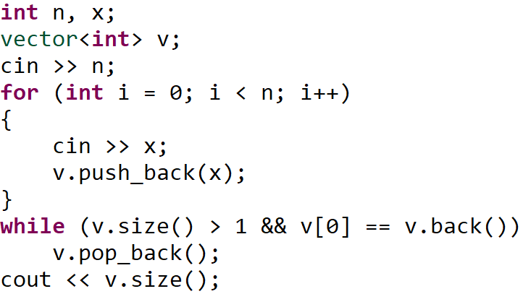
|Solution

Slide 19
Stack
Last In First Out

Slide 20
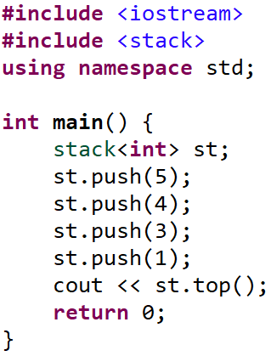
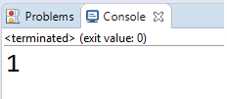
|Stack
.push()
Push elements to stack.
.top()
Show the top of stack.

Slide 21
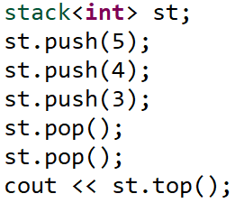
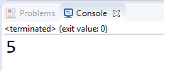
|Stack
.pop()
Pop the top of stack.

Slide 22


|Exercise
Koko will be given a sequence of brackets ‘{‘, ‘}’. His task is to check whether this sequence results a regular brackets sequence or not, "{}", "{{}}" are regular bracket sequences while "{{", "{}{", are not. print yes if it's a regular bracket sequence otherwise print no.

Slide 23
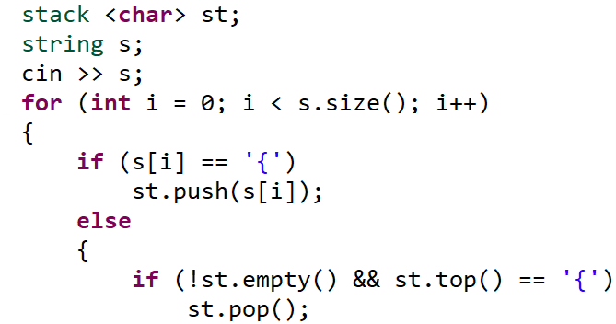
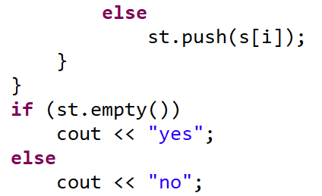
|Solution

Slide 24
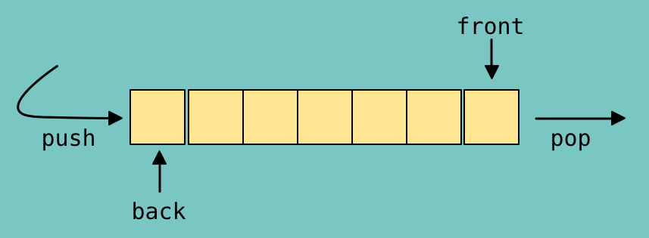
Queue
First In First Out

Slide 25
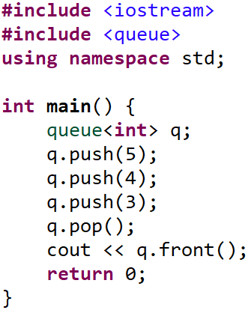
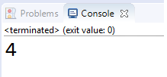
|Queue
.push()
Push elements to queue.
.pop()
Pops the front of queue.
.front()
Gets the front of queue.
5

Slide 26
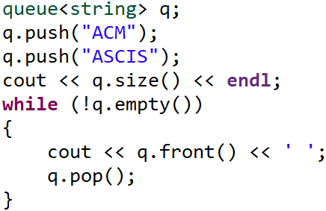
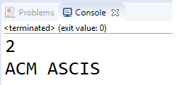
|Queue
.empty()
Returns true if the queue is empty.
.size()
Returns the size of the queue.
5

Slide 27
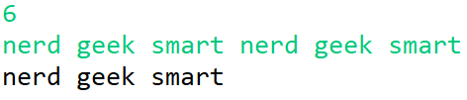
|Exercise
Koko ranks students according to their intelligence. N students will enter the magical ACM bus in a queue, but the queue to ACM bus has some magical rules, when one student come in the back of the queue the mentors check whether the first one in the queue has the same rank of him or not,, if the last rank matches the first one, the first one will enter the bus. ranks of students according to Koko are "smart", "geek", and "nerd", you should print the ranks of the students that will stand in the queue from the beginning to the end after that the N students came to stand in the queue.

Slide 28
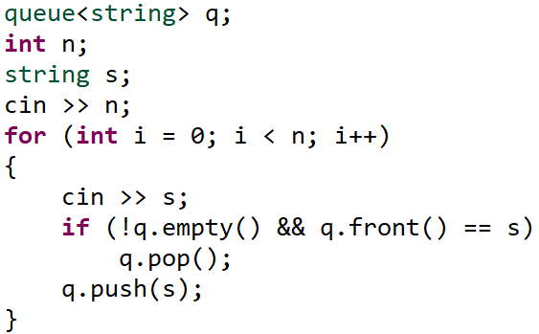
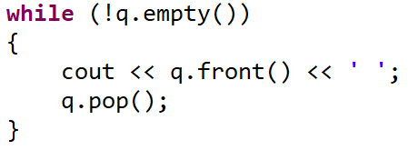
|Solution

Slide 29
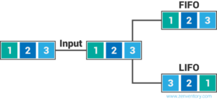
|Queue VS Stack

Slide 30
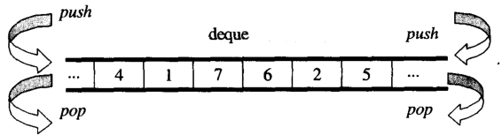
Deque
- Double Ended Queue -

Slide 31
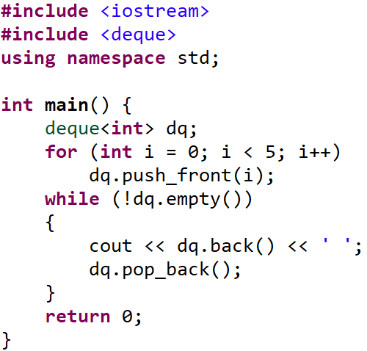
|Deque

Slide 32
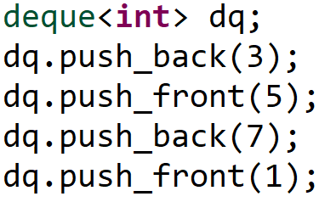
|Deque
.push_back()
Push elements to the back of deque.
.push_front()
Push elements to the front of deque.

Slide 33
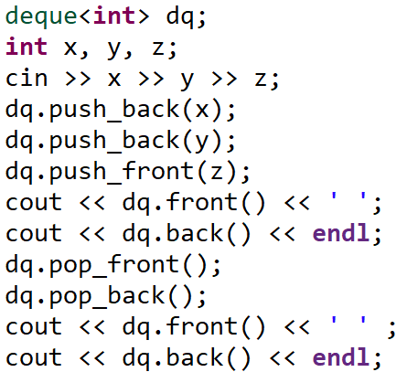
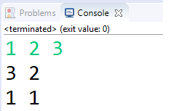
|Deque
.pop_back()
Pop elements from the back of deque.
.pop_front()
Pop elements from the front of deque.

Slide 34
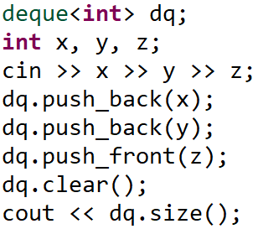
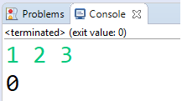
|Deque
.clear()
Clear the deque from all its elements.
.size()
Returns the size of the deque.

Slide 35
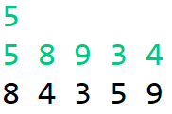
|Exercise
Koko is given N integers he wants to print even numbers in descending order then the odd numbers in ascending order using deque.

Slide 36
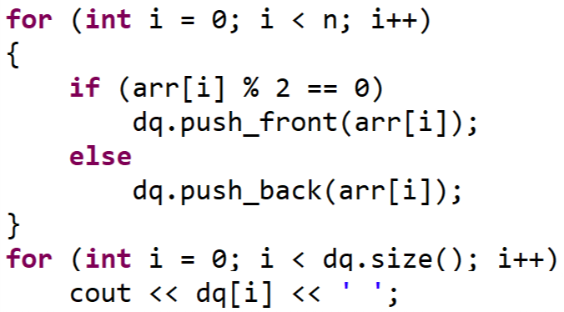
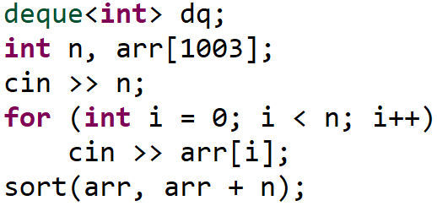
|Solution

Slide 37
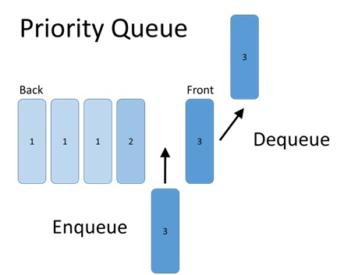
Priority Queue
- Auto sorting Queue -

Slide 38
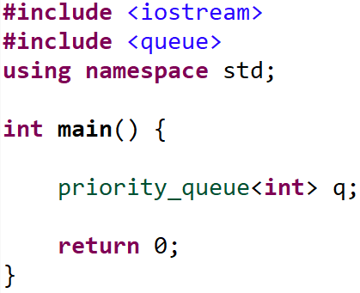
|Priority Queue
Priority queue sorts the elements in descending order so the top element will be the biggest.

Slide 39
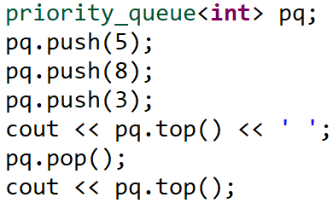

|Priority Queue
.push()
insert element in its order in the queue.
.top()
Gets the element on the top of queue.
.pop()
removes the top element in the queue.

Slide 40


|Priority Queue
This declaration of priority queue makes it sort the elements in ascending order means that the top of queue will be the smallest element.

Slide 41

|Exercise
Koko thinks that the larger lexicographical a name is the better it is, so he will give you N upper case names and you should print the largest lexicographical name.

Slide 42

|Solution

Slide 43
Map

Slide 44

Binary Search Tree
Notes:
Unlike Arrays, Stack and queues, which are linear data structures, trees are hierarchical data structures.
Binary search Tree provide moderate access / search (slower than arrays).
Binary search Tree provide moderate insertion/ deletion (quicker than Arrays).

Slide 45

|Map
map <Key, Value> map_name;
You can use any data type you want whether in the key or the value.

Slide 46

|Map
Assign a value to some key.

Slide 47


|Map

Slide 48


|Map
.clear():
Removes all elements from the map.

Slide 49



|Exercise
Koko is appointed as the assistant to a teacher in his school while he was correcting the answer sheets of the students, he found that each student can have multiple answer sheets. So the teacher has 3 types of queries:
1 X Y: Add the marks Y to the student named X.
2 X: Erase all the marks of the student named X.
3 X: Print the marks of the student named X. (If X didn't have any marks print 0.)
Write a program that takes T (number of queries).

Slide 50


|Solution

Slide 51
Set
- Auto sorting without repetition container -

Slide 52

|Set
set <Key> set_name;
Set doesn’t repeat elements.
Set can sort in both orders(decreasing, and increasing).

Slide 53

|Set
.insert():
inserts element in the set in its order in O(log(N)).

Slide 54



|Iterator
An iterator is an object that points/refers to an element of a sequence.
The end of the sequence is one past the last element.

Slide 55


|Exercise
Koko’s mom sent him to the shop to buy some groceries, but she gave him a very weird shopping list, he found that many items in this list are repeated. He wants you to help him create a new list, where each item is unique.

Slide 56

|Solution

Slide 57

|Challenge
What are those functions complexity?!
Notes:
complexity of all stls functions

Slide 58
Prime Factorization

Slide 59


|Prime Factorization
Each number can be made from prime numbers multiplied by each other.
24
3¹ * 2³
28
2² * 7¹

Slide 60
Sieve of Eratosthenes

Slide 62

|Sieve

Slide 63

|Challenge
Can we further optimize the complexity of Sieve?!
Notes:
Optimization in Sieve
The Inner loop: j can start from i * i
The Outer loop: i can iterate until sqrt(n)

Slide 64


